Slide 1
BIG DATA
WELCOME
TO

Slide 2
Hive
Hive is a data warehouse infrastructure tool to process structured data in Hadoop.
Resides on top of Hadoop
Makes querying and analyzing easy.

Slide 3
Features of Hive
It stores schema in a database and processed data into HDFS.
It is designed for OLAP.
It provides SQL type language for querying called HiveQL or HQL.
It is familiar, fast, scalable, and extensible.

Slide 4
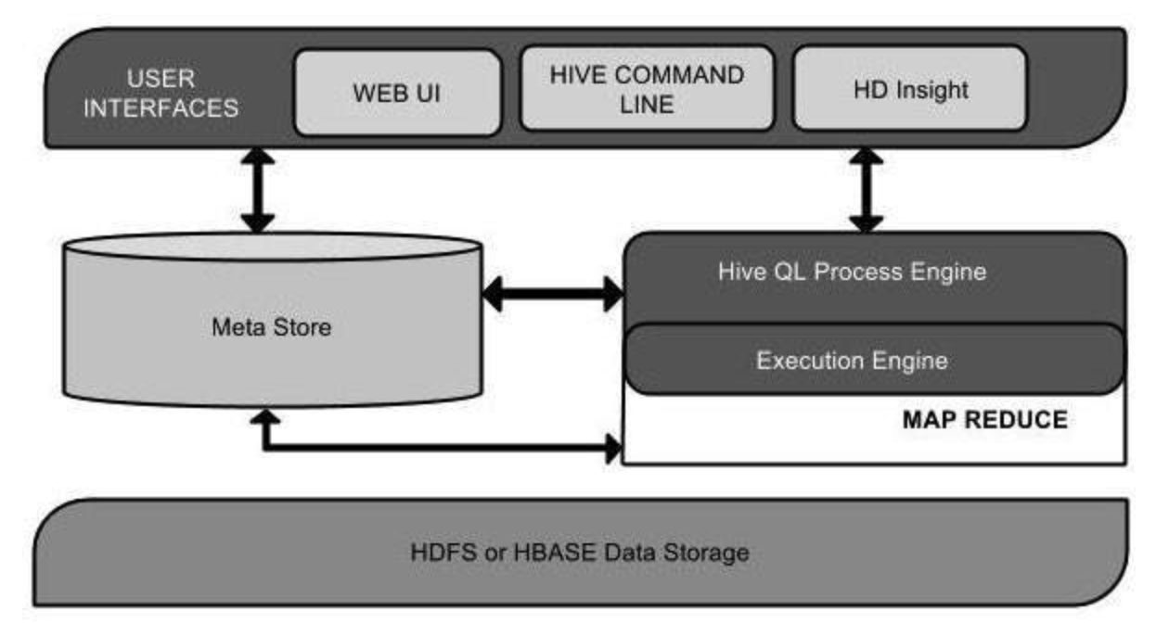
Architecture of Hive
User Interface
Meta-store
Database servers to store the schema or Metadata of tables.
HiveQL Process Engine
Similar to SQL for querying on schema info on the Meta store
MapReduce Jobs
Execution Engine
Processes the query and generates results same as MapReduce results

Slide 5
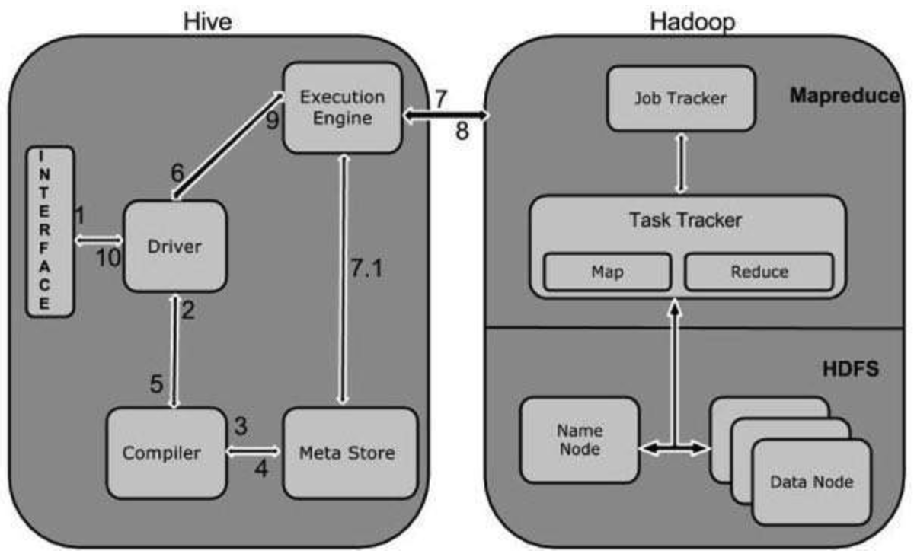
Working of Hive

Slide 6
Hive Tables
Internal tables
Internal Table is tightly coupled
In this type of table, first create table and load the data.
By dropping this table, both data and schema will be removed.
The stored location of this table will be at /user/hive/warehouse.
Hive>CREATE TABLE hive_internaltable (id INT, Name STRING);
Row format delimited
Fields terminated by '\t';

Slide 7
Hive Tables
External tables
External Table is loosely coupled.
By dropping this table, only schema gets dropped, the data will be still available in HDFS
External tables provide an option to create multiple schemas for the data stored in HDFS instead of deleting the data every time whenever schema updates
Hive > CREATE EXTERNAL TABLE hive_external (
id INT,Name STRING)
Row format delimited
Fields terminated by '\t’
LOCATION /bigdata/hive_external;

Slide 8
Hive Partition
Hive Partitions is a way to organizes tables into partitions by dividing tables into different parts based on partition keys.
Partition keys are basic elements for determining how the data is stored in the table.
Hive > CREATE TABLE enhanceit_hive (id String, name String, department String)
PARTITIONED BY(department String);

Slide 9
Hive buckets
Buckets in hive is used in segregating of hive table-data into multiple files or directories
Data present in partitions can be divided further into Buckets
Bucketing is used for efficient querying
Hive > CREATE TABLE hive_samplebucket
(id INT, name STRING, department STRING)
Clustered by (department) into 4 buckets
Row format delimited
Fields terminated by ‘ , ’;

Slide 10
Hive Queries
Order By
Uses columns on Hive tables for sorting particular column values mentioned with Order By
Group By
Use columns on Hive tables for grouping particular column values mentioned with Group By
Sort By
Performs on column names of Hive tables to sort the output
DESC for sorting the order in descending order and mention ASC for Ascending

Slide 11
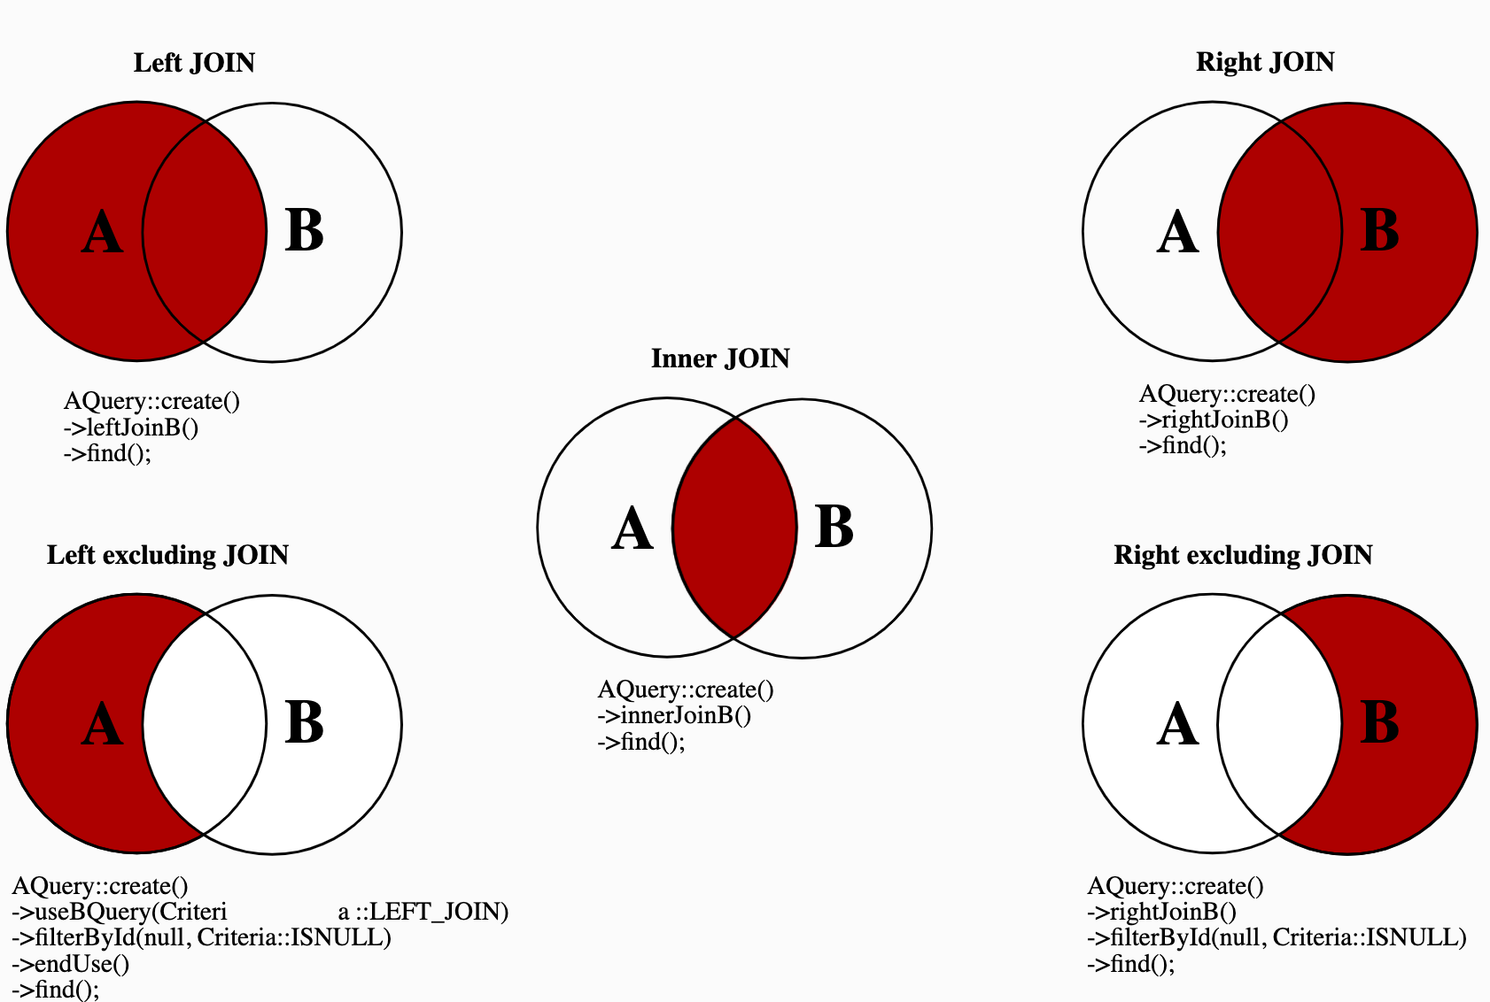
Hive Joins
5 types of Join

